Slide 1
GWU Data Science Capstone Thomas Keeley & Harry Newton
Faculty Advisor: Dr. Amir H. Jafari
Suggested Journal Title: Using Data Science and Remote Sensing to Understand Ship Traffic with Application to Detecting Forced Labor (Human Trafficking)

Slide 2
Outline
Problem Statement
Literature Review
Data Sources
Modeling Approach
This week & next

Slide 3
Problem Statement
1. Develop a Machine Learning (ML) model to identify ships in imagery data 2. Develop a pattern analysis Data Visualization (DV) based on navigation signals data from Spire and Global Fishing Watch 3. Combine these models and data to improve the ML model 4. For an application of these models and data, propose a risk assessment framework for Forced Labor sometimes present in the fishing industry.

Slide 4
Literature Review
Flat Files,
Spreadsheets

Slide 5
Literature Review-Human Trafficking
Kroodsma, D.A., N.A. Miller, and A. Roan 2017. “The Global View of Transshipment: Revised Preliminary Findings.” Global Fishing Watch and SkyTruth, July 2017. Available online at http://globalfishingwatch.org.
“An AP investigation helps free slaves in the 21st century,” a series of articles over 18 months for which they won the Pulitzer Prize for Public Service on April 18, 2016.
Google BigQuery Geographic Information System documents
Have introduction now to leadership at Global Fishing Watch and Liberty Shared, so can get a subject matter expert review of DV Model assumptions & results

Slide 6
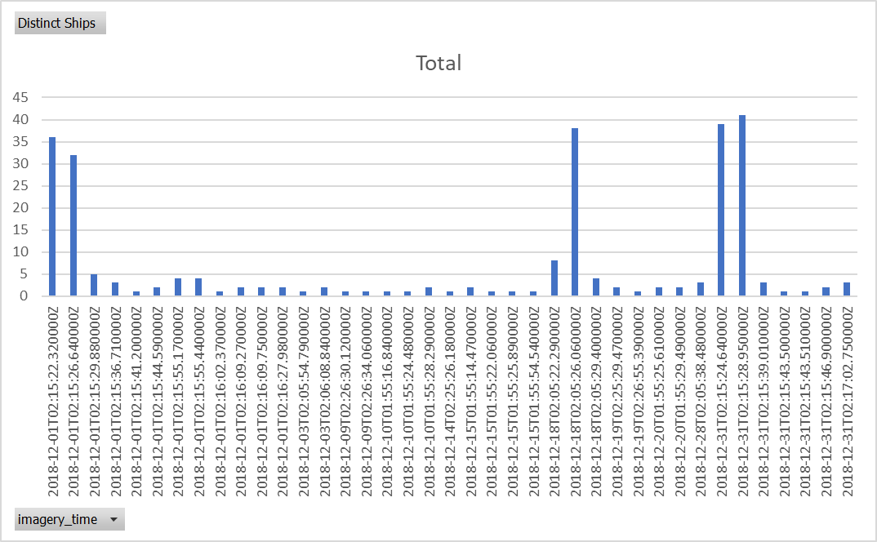
Images w/ co-incident Signals (Count of Distinct Ships)

Slide 7
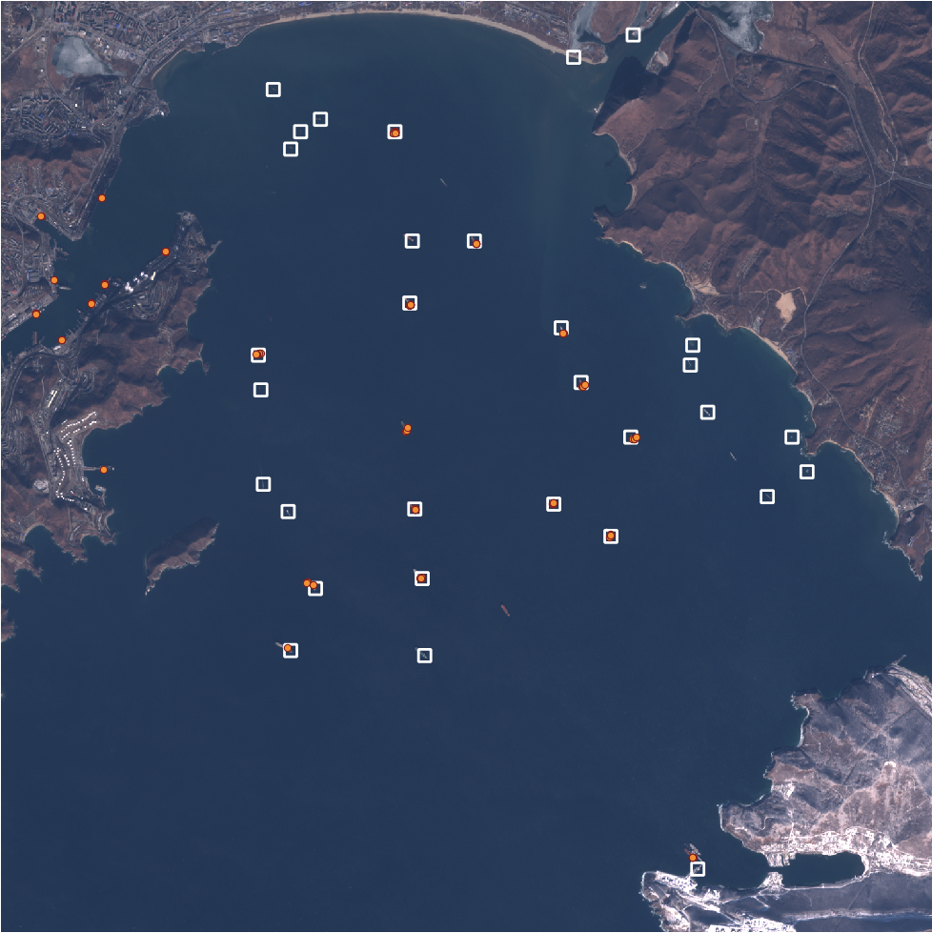
AIS + GIS + Detections

Slide 8
Modeling Progress (Green is done, Blue is newly done)
Automated Identification System (AIS)
Identify HT risk factors by combining AIS data into voyages
-Gaps in reports
-Ship Tracks -Long voyages
-Changes in registration
Object Detection in GIS Satellite Imagery
-ML to identify ships in coastal GIS data near ports
-Shifted to larger data library
-Added utilities for images
-Time Series
-Use AIS to speed training, instead using AIS to show effectiveness
Joint Model (AIS+GIS)
Identify Gaps in data
-API for GIS data
-API for AIS data
(In Google & Local Machine)
-Gaps in AIS based on GIS
-Gaps in GIS based on AIS
-Identify ships with risk factors
-Encounters
Data Visualization Model
Visualization of Risk Factors indicating Human Trafficking
Met w/ Expert
Figure 1 Overall Methodology

Slide 9
This week & next—8/6/2020
This Week:
Now have joint AIS + GIS data. AIS 2018 data from Global Fishing Watch released and more GIS data (same data formats as previously, but using an index and source that has more of the images).
MVP2 for Joint AIS+GIS model in Google BigQuery to identify matching data from both modes
Test using joint data shows strong performance from GIS Object Detection
Added details on object detection to report
Next Week:
Decide if one combined journal submission or two smaller ones.
Share Human Trafficking model with Human Rights data science expert for feedback
Video & Report

Slide 10
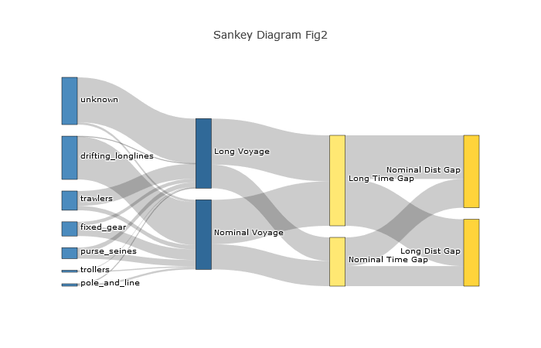
Data Visualization (so far)

Slide 11
This week & next—7/23/2020
This Week
Models: GIS Model improved. AIS Model improved. MVP1 for Data Visualization
Data: AIS Sample datasets and python code to call API
Next Week:
Start MVP1 for Joint AIS+GIS model
Share results and approach with Global Fishing Watch POC for feedback
Backlog:
Google BigQuery Graphical Information System (haven’t needed)

Slide 12
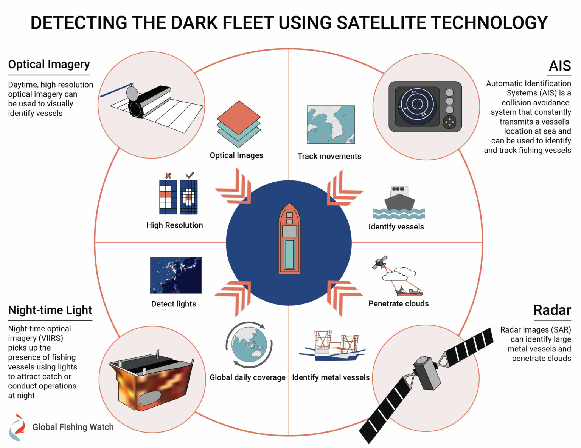
https://globalfishingwatch.org/data/cooperation-uncovers-illegal-fishing/

Slide 13
This week & next—7/30/2020
This Week
Models: GIS Model improved. AIS Model improved. MVP1 for Data Visualization
Data: AIS Sample datasets and python code to call API
Next Week:
MVP1 for Joint AIS+GIS model on laptops
MVP1 for Joint AIS+GIS+others(?) on Google
Share results and approach with Global Fishing Watch POC for feedback
Backlog:
Google BigQuery Graphical Information System

Slide 14
AIS Model
Human Trafficking Risk Factors | Progress
Long voyages | Tested logic to separate the 28.5M AIS reports by ships (and type) then into voyages between dockings
Gaps or fakes in AIS locations | Have researched past approaches. Once ready also goes in AIS + GIS model
Encounters | Have example encounters from LitRev & GFW tool hosted in Google
Changes in registration | Identifying data source. Have reviewed past approaches on GitHub.
Identify HT risk factors by combining AIS data into voyages
-Gaps in reports
-Ship Tracks -Long voyages
-Encounters
-Changes in registration

Slide 15
Object Detection in Satellite Imagery
Develop an open source Geographic Information System (GIS) model/toolkit
Provide the capability to conduct object detection in satellite imagery
Produce training data based on AOI
Train model with minimal computing resources
Conduct predictions of object presence and location in collection of imagery
Incorporate predictions into training dataset to improve accuracy
Produce geographic output with attribution

Slide 16
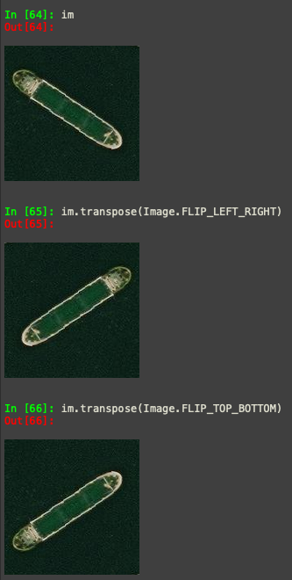
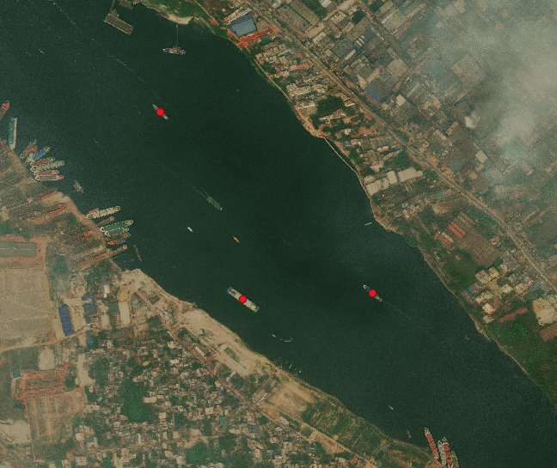
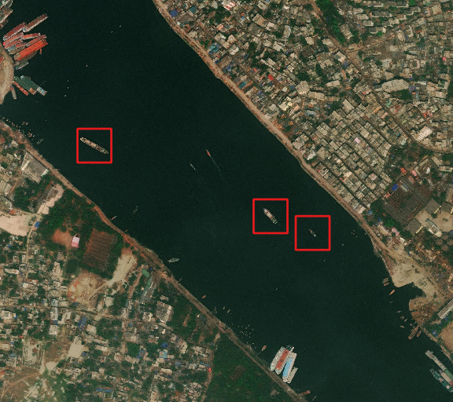
Create Training Data
Figure 2 Mark Known Objects
Figure 3 Create Buffer and Clip to Extent
Figure 4 Image Augmentation of Training Data

Slide 17
Training Model and Conducting Object Detection
Current implementation utilizes a simple Keras sequential model for classification
Model trains on data produced by user and classifies image chips as being “ship” or “no ship”
AOI imagery is then used for detection testing using two different methods
Moving window
Image segmentation
Predictions are made on the AOI images and exported as geographic data

Slide 18
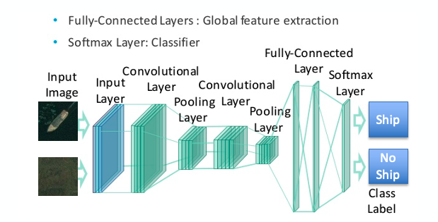
Building the Model

Slide 19
Preparing Satellite Imagery
Figure 5 AOI Satellite Image
Figure 6 Masked Image
Figure 7 Image Segmentation

Slide 20
Results & Next Steps
Accurate results with acceptable processing speed
Continue applying to lower resolution imagery (10m)
Develop batch processing and continual training data update
Build the GIS process model and develop code into module
Test in cloud environment for application deployment

Slide 21
Data Sources
Maxar Technologies https://www.maxar.com/open-data
European Convention https://scihub.copernicus.eu/
Global Fishing Watch https://globalfishingwatch.org/map-and-data/
Spire Satellite API for AIS Data: https://developers.sense.spire.com/get-started
Google BigQuery GIS Data: https://cloud.google.com/bigquery/

Slide 22
This week & next
Added Literature Review for Human Trafficking examples using Remote Sensing
Tested API link to get AIS data from a backup source: Spire (satellite company)
Researched Google BigQuery Graphical Information System, which claims to have all public-domain remote sensing (AIS, GIS, others) available and python geo library.
For DV model, analyzed current dataset for AIS for first risk factor of abnormally long voyages for ship type: analyzed signals (28.5M) to ships (354) to voyage lengths.
Next Week: Experiment in Google Cloud with all of the above

Slide 23
Your Questions & Advice

